Slide 1

19ECE457 Wavelets and Applications Project:Image Fusion
TEAM 2
Amirdhavarshini T CB.EN.U4CCE21005
K Pooja CB.EN.U4CCE21027
Supraja Gomathi K CB.EN.U4ECE21153

Slide 2
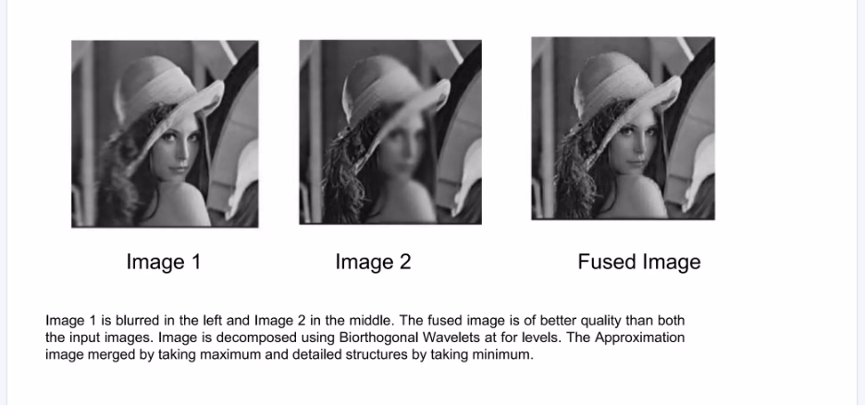
Introduction and tools used
In image fusion, wavelet transform is used to extract high-frequency details (edges, textures) and low-frequency components (overall structure) from input images.
The goal is to combine these components from multiple images into one, preserving the most significant details.
Tools/Libraries used:
Tools:Jupyter Notebook

Slide 3
Methodology
Get the images to be fused(OpenCV: To read the images.)
Apply the wavelet transform on both the images through chosen wavelet at the desired level(PyWavelets: To perform the wavelet transform)
Get the approximation and detail coefficients for both the images(PyWavelets: The wavedec function returns the approximation and detail coefficients.)
Merge the coefficients by desired fusion rule(NumPy: To perform operations on the coefficients.)
Apply Inverse discrete wavelet transform on the merged coefficients and get the fused image(PyWavelets: To perform the inverse wavelet transform)

Slide 4
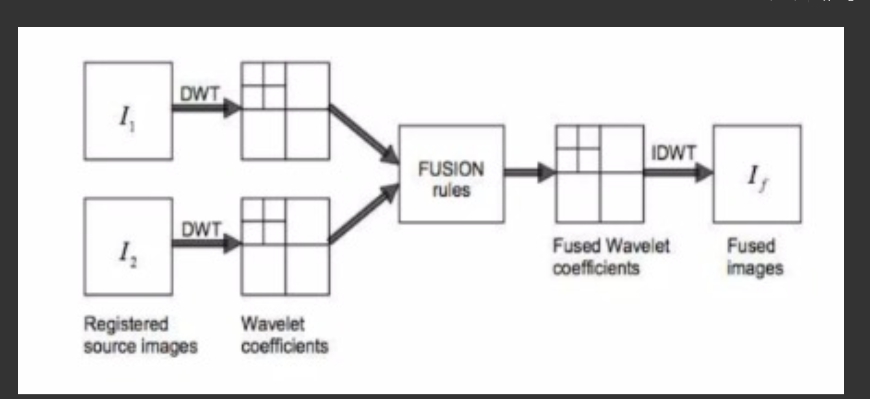

Slide 5
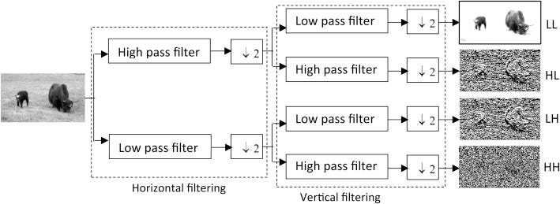
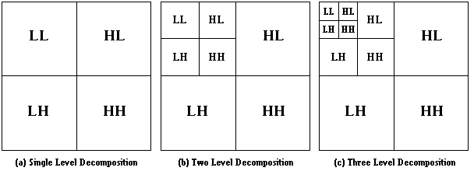
DECOMPOSITION OF IMAGE

Slide 6
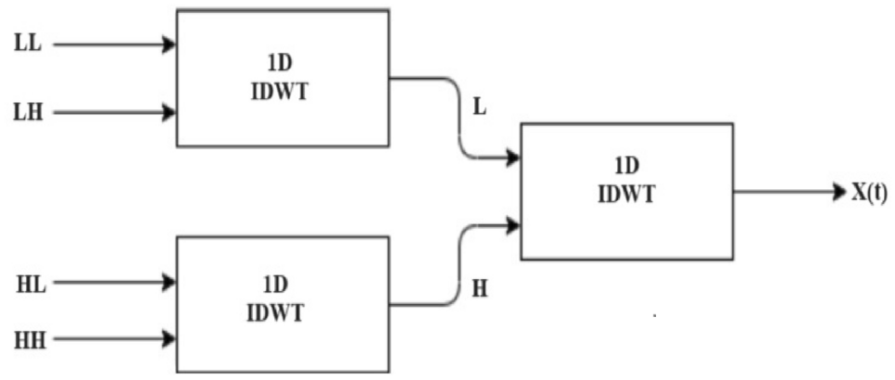
RECONSTRUCTION OF IMAGE

Slide 7
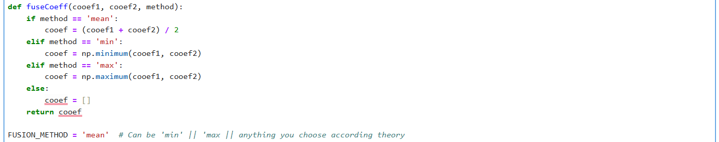
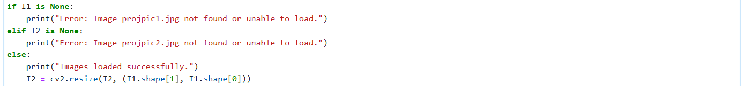
CODE IMPLEMENTATION
Imports the required libraries
Fuses two wavelet coefficients based on the specified fusion method (mean, min, or max).
Resizes the second image to match the dimensions of the first image.

Slide 8
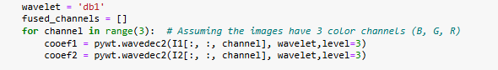
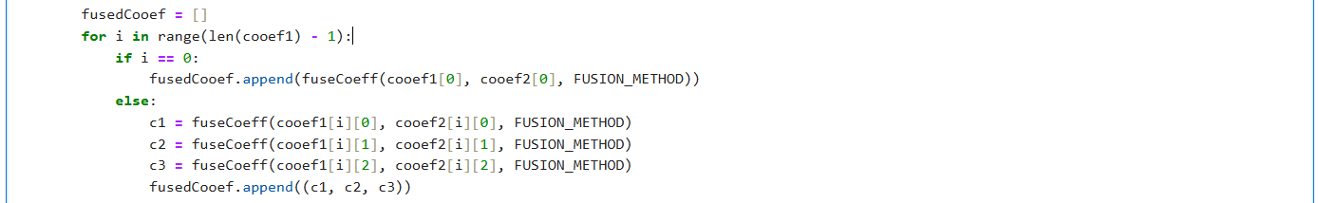
Contd..
Fuses the approximation coefficients from the wavelet decomposition of both images' color channels.
Fuses the detail coefficients (horizontal, vertical, and diagonal) from both images' color channels for each decomposition level.
Reconstructs the fused color channel image from the fused wavelet coefficients.
Merges the fused color channels back into a single RGB image.

Slide 9
Contd..
Merges the fused color channels back into a single RGB image.
Normalizes the fused image to the range [0, 255] and converts the normalized fused image to an unsigned 8-bit integer format for display.
Displays the fused image in a window,Waits for a key press to close the displayed image window.
Closes all OpenCV windows.

Slide 10
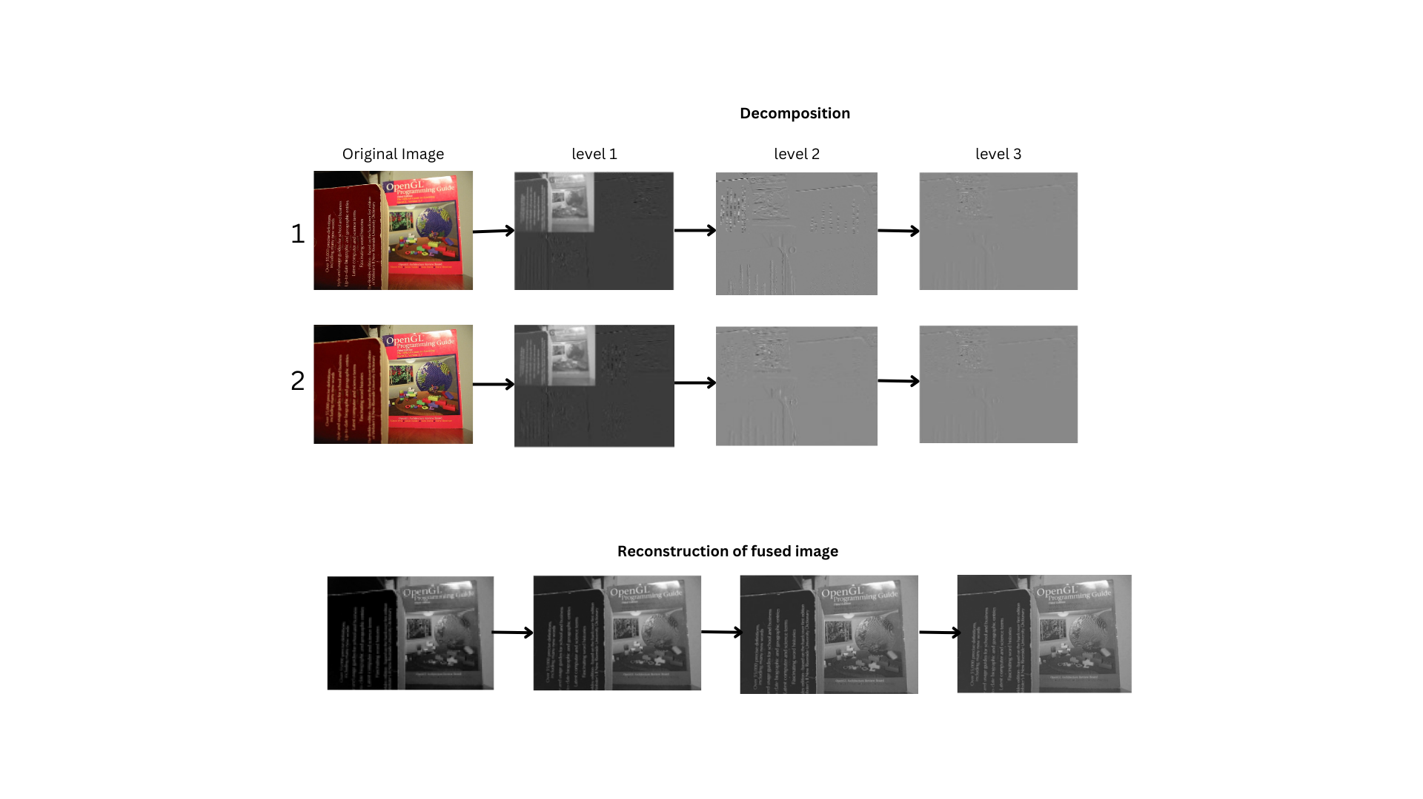

Slide 12
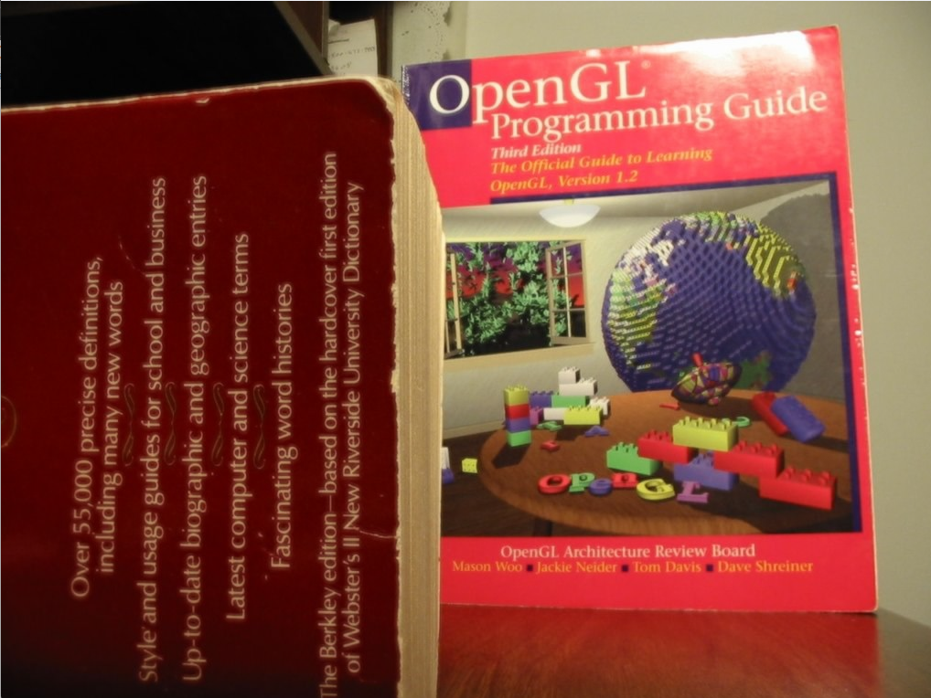
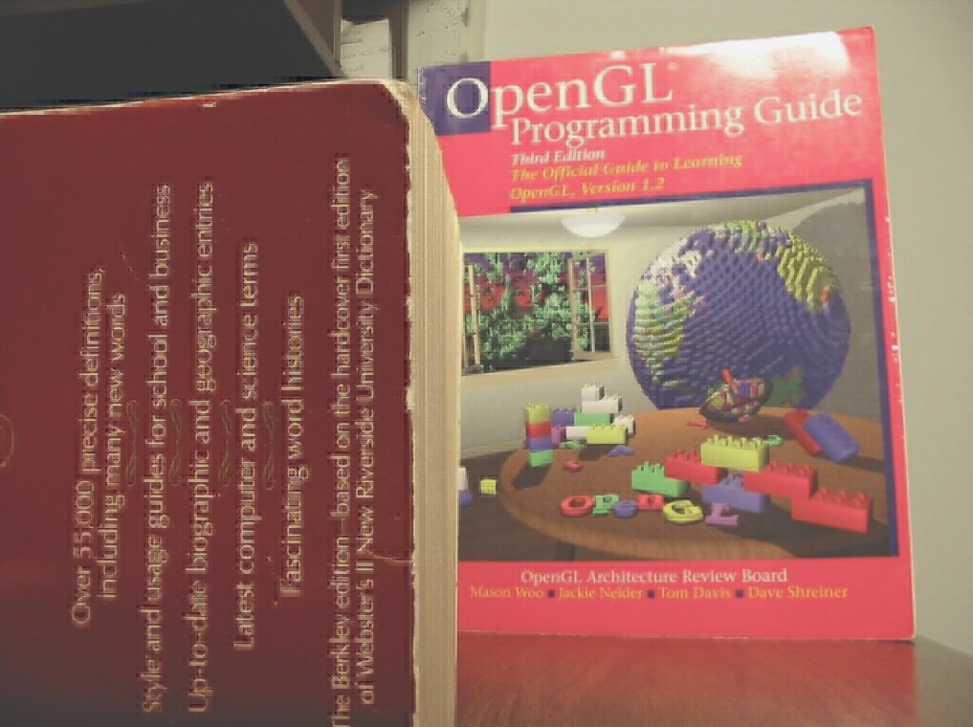
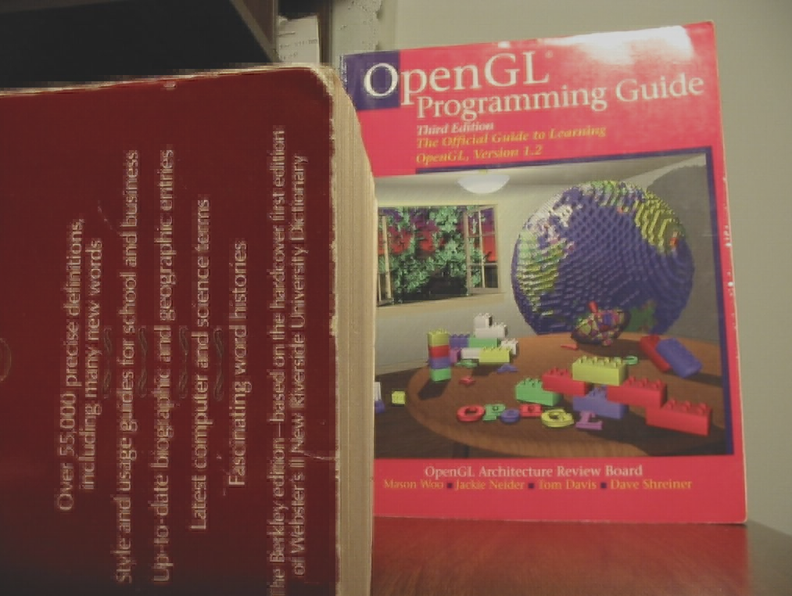
FINAL OUTPUTS
Using mean fusion rule
Using min fusion rule
Using max fusion rule

